Slide 1
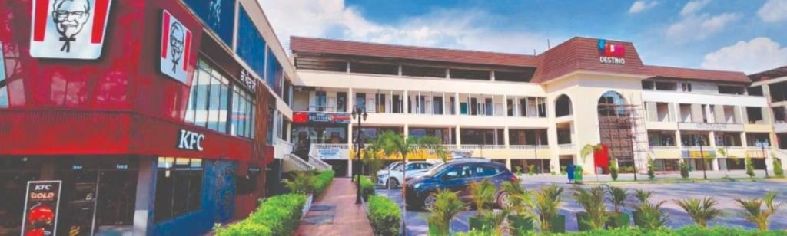
Fun Destino Mall
Exclusive Investment Opportunity for ALL & NRIs
A premium retail and lifestyle destination offering NRI investors secure, income-generating opportunities through structured shareholding or commercial property ownership.

Slide 2


Benefits of Pre-Leased Commercial Properties
Assured Fixed Monthly Income
Guaranteed 10% Property Appreciation yearly
Future Growth with Less Investment
15% Assured Rental Increment after 3 years
Commercial Showroom Ideal for investment or own business use.
Secure & Stable Fixed Returns for Salaried, Businessman & NRI Investors

Slide 3

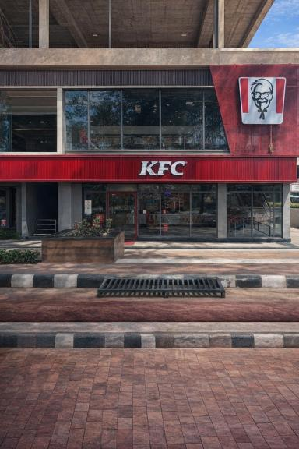
Earn Monthly Fixed Rent
Smart Commercial Investment With Assured Income
Monthly Fixed Rent ₹25k - ₹ 7 Lakh
Zero Tenant & Management Hassle
Ideal For NRI & Smart Investors
Future Growth with less Investment

Slide 4




Fun Destino Mall – At a Glance
Prime Location
Integrated Tourist Hub
Hoshiarpur Road , Garhshankar, Punjab on major highway corridor
Mall, food courts, entertainment, and family
attractions
High Footfall
Year-Round Events
Designed to attract branded tenants and consistent visitor traffic
Regular festivals, shows,and community gatherings

Slide 5

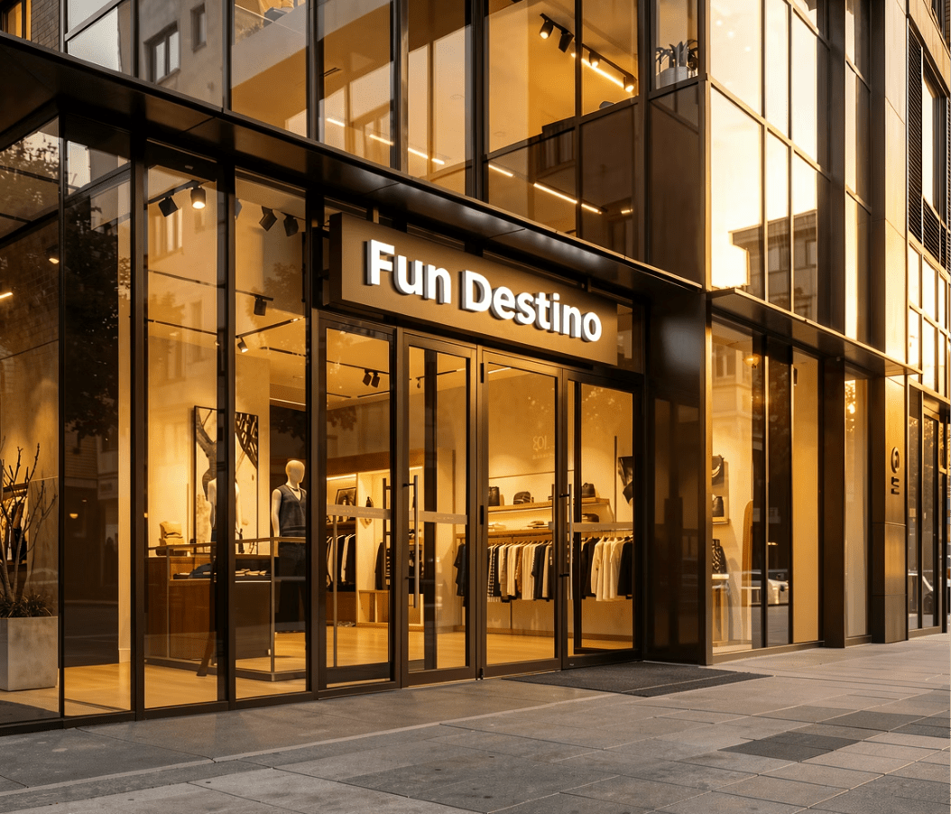
Two Secure Investment Paths
Option 1: Structured Shareholding
Option 2: Buy Commercial Property
Demat-based financial instrument with fixed returns, regulated transparency, and professional management.
Physical real estate with immediate possession & Registry with assured lease, and hands-free Passive rental income.
Both options engineered for passive income and long-term capital appreciation.

Slide 6
Option 1: Structured Shareholding
Investment Start Range
Project Valuation
₹10 – ₹25 Lakhs Ticket Size
₹200 Crore certified by IBBI-registered valuer
Fixed Dividend
Lock-in Period
12% per annum guaranteed returns
2 years for stability and Passive growth
Why Choose Fun Destino Mall
NSDL-listed shares held in your Demat account
No property registration
Life Time Dividend Opportunity
Zero operational involvement required
Fixed 12% annual income with no volatility
Transparent, regulated structure
Professional project management
Future Growth with Less Investment

Slide 7






Why Choose Shareholding?
Fixed Annual Income
Regulated & Transparent
12% p.a. dividend paid regularly with predictable cash flow for financial planning
NSDL-listed shares with full compliance, audit trails, and investor protection
Easy Company Stake Holding
Zero Management
Shares held in your Demat account, accessible and transferable like any stock
Professional team handles operations, leasing, and tenant management completely
Passive Investor Friendly
Capital Appreciation
No property management stress, perfect for NRIs and busy professionals
Benefit from project growth and increasing mall
valuation over time

Slide 8
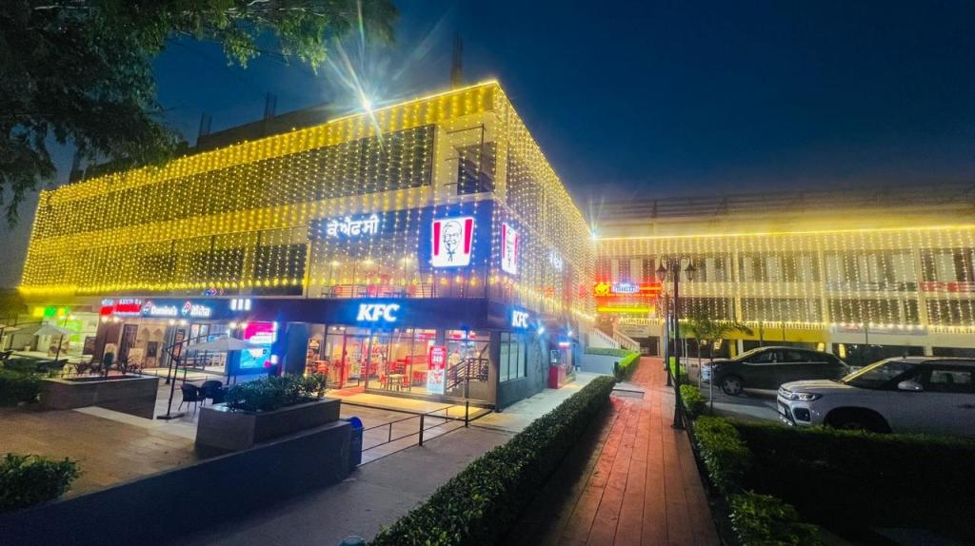
Option 2: Buy Commercial Property
Immediate Registry
Get registered ownership and possession right away
9-Year Lease with Minimum 18 Months Lockin Period
Long-term assured rental agreement with MNC tenants
15% Escalation
Rent increases every 3 years for inflation protection
~10% Appreciation
Expected annual capital value growth
Choose from branded showrooms, food counters, or entertainment booths – all with professional fit-out and turnkey operation.

Slide 9




Investment Vs Monthly Rent
₹31 Lakhs Investment
₹55 Lakhs Investment
Monthly Rent: ₹16,000
Monthly Rent: ₹17,500
Format: Booth (₹31L property + ₹7L CAPEX)
Format: Counter (₹35L property + ₹20L CAPEX)
₹1.5 Crore Investment
₹2 Crore and Above Investment
Monthly Rent: ₹75,000
Fixed Monthly Rent: ₹1,00,000
Showroom + CAPEX Excluded
Premium Showroom + CAPEX Excluded

Slide 10
Referral Income
Level 1
Level 2
Level 3
Level 4
Executive Consultant
(Pearl Level)
Consultant
Senior Consultant
Portfolio Advisor
(Sapphire Level)
3%
2%
1%
0.5%
Level 5
Level 6
Level 7
Level 8
Wealth Advisor
(Emerald Level)
Private Client Advisor
(Ruby Level)
Legacy Partner
(Diamond Level)
Elite Legacy Partner
0.5%
0.5%
0.5%
0.5%
Level 9
Global Wealth
Partner
Magic Booster For All
0.5%
10% of Referral Income to Every Sponsor

Slide 11
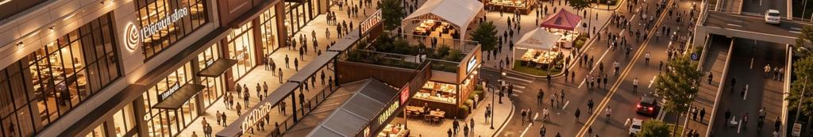
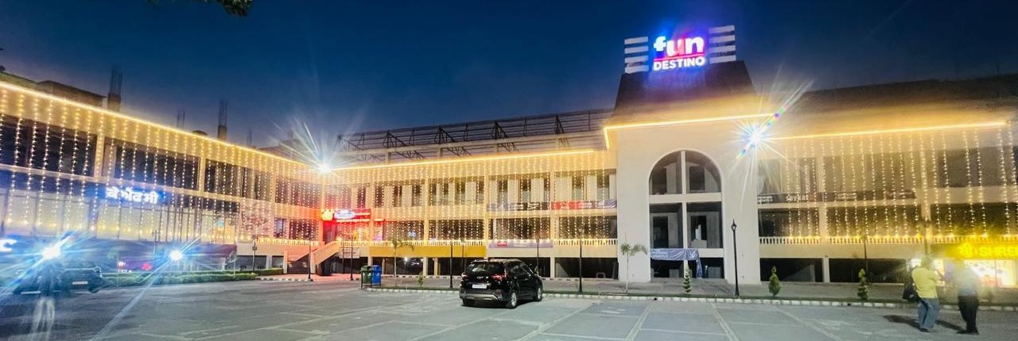
Why Fun Destino Works
Integrated Destination
Prime Highway Location
Mall, food courts, entertainment, and family attractions under one roof
High visibility and accessibility on major transportation corridor
Regular Events
Growing Footfall
Festivals, shows, and community gatherings drive consistent footfall
Increasing tourist and local visitor traffic
year-round

Slide 12
Why You Should Prefer This Investment
Assured Income
Fixed rental or dividend income provides stable rupee-denominated returns, hedging against
currency fluctuations
Zero Management Hassle
Professional team handles all operations, tenant relations, and property management – no need to travel or coordinate locally
Flexible Asset Choice
Option of financial instrument (Demat shares) or physical real estate based on your investment preference
Long-Term Appreciation
Property value and rental income grow over time, building wealth for future generations
Legacy Investment
Perfect addition to India portfolio, creating tangible assets for family wealth transfer and inheritance

Slide 13
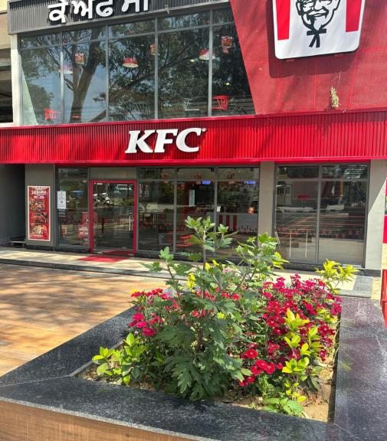




Contact us for Site Visit
Website
www.fundestino.in
Email
fundestinomall@gmail.com
Phone No.
8130570502, 9815580037
Address
Home Destino Private Limited (HK Developer)
Ground Floor Adj, Maruti Showroom
Hoshiarpur Road Garhshankar-144527 (Pb)

